Slide 1

ONLINE TICKET BOOKING SYSTEM
(Phase 2)
October 21, 2020
By Team 3:
Rudy Bi
Cinthia De La Cruz
Mamadou Diallo
Jackson Gable
Daphne Gao

Slide 2

Executive Summary & Introduction
Update current and outdated ticket purchasing system in place
Create and develop an online ticket booking system that will provide users with a fast and secure experience
Utilize Scrum as the agile method which allows adaptability as the project progresses
Scrum Activities:
Initiate
Plan
Execute
Monitor and Control
Close

Slide 3






Out with the Old - In with the New
OLD
NEW

Slide 4
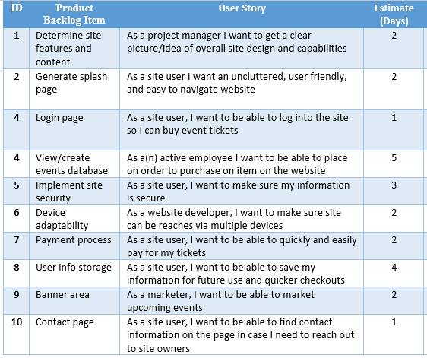
Product Backlog
A list of features prioritized by business value
[1]
[1] Schwalbe, K. (2019). Information Technology Project Management, 9th Edition. Cengage Leaning Course Technology. ISBN: 9781337101356

Slide 5
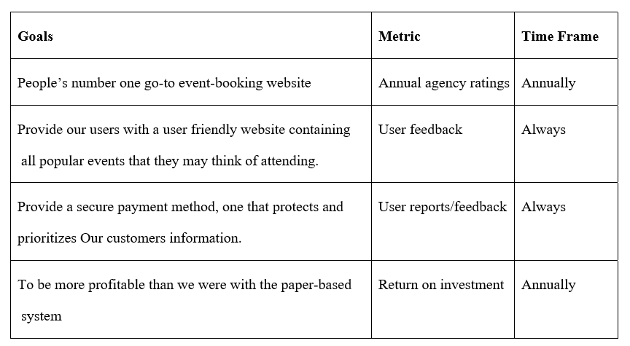

Slide 6
Questions:
Will the initial budget suffice throughout the project or are we going to need more funding in the future?
Do we have all the necessary skills to implement a secure payment system and sophisticated database?
Will our users find this new system better suited for them compared to the old one?
Will the new system generate more profit for the agency and how long will it take for that to happen?
Assumptions:
We assume the website is smooth enough to support large traffic in the case of many users booking at the same time.
We assume our website will provide secure methods to avoid user’s data being stolen.
We assume that there’s a database in the backend to store a user’s data as backup.

Slide 7
In scope: The following features are within the scope of our website
Being able to access and to log-in to the website using user-info.
Being able to access the event info page and browse a specific event to book.
Being able to confirm and move to the checkout page to pay for the ticket.
Not in scope: The following feature is not currently in-cooperated in our website.
Being able to book multiple events at the same time (If the events are different).

Slide 8
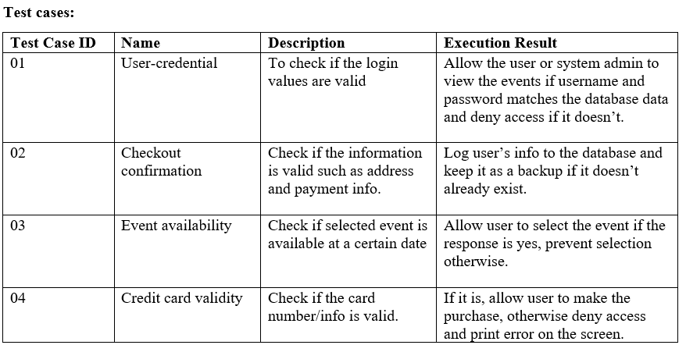

Slide 9
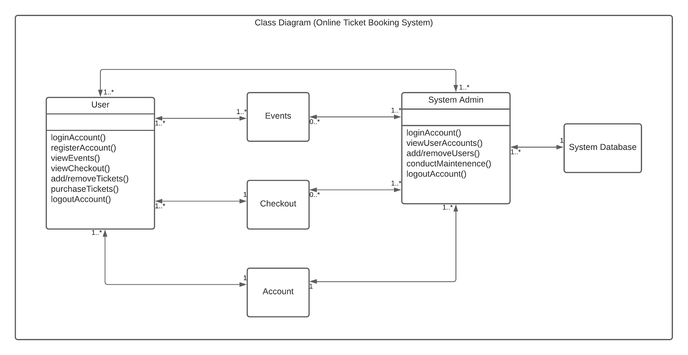

Slide 10
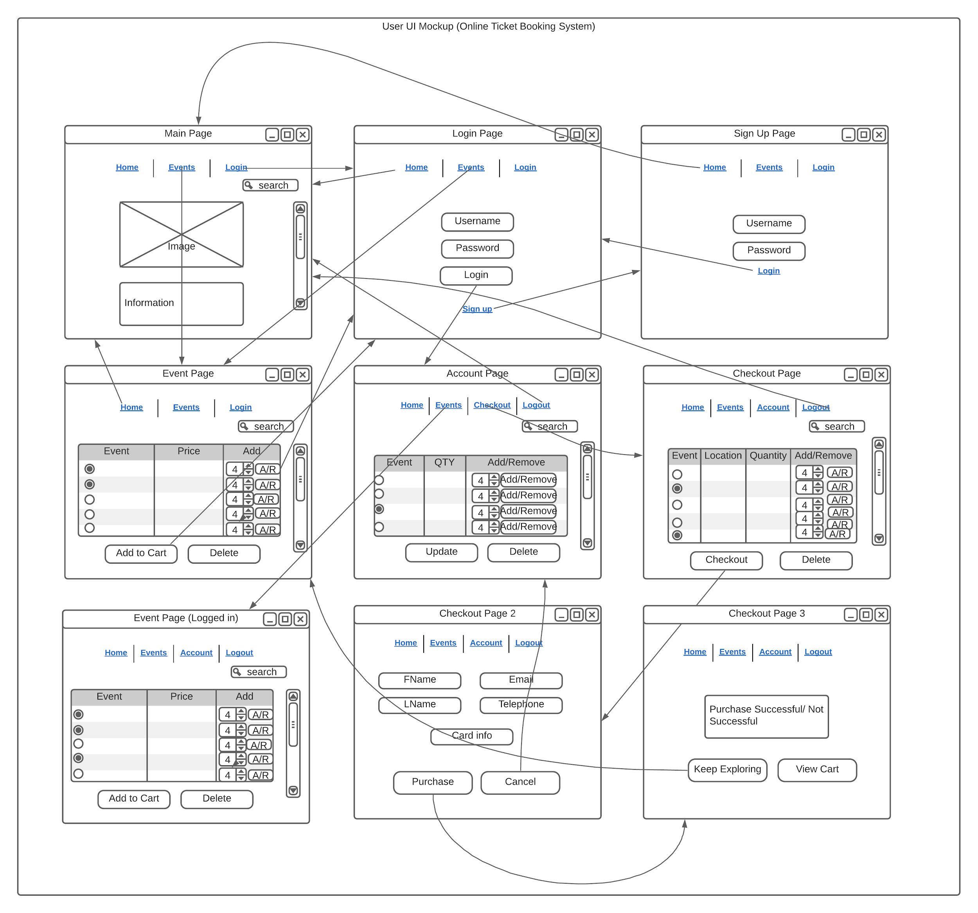

Slide 11
Sprint #1 Backlog

Slide 12
Splash Page
Product Backlog ID | Product Backlog Item | User Story | Task | Task Owner | Estimate (Days) | Actual (Days) | Status
1-01 | Create splash page | As an end-user, I want to be introduced with a sleek, welcoming homepage, so that I can recognize the company’s brand while having a streamlined experience | Design business logic | Rudy | 1 | - | To Do
 |  |  | Design UI | Rudy | 1 | - | To Do
 |  |  | Develop back-end | Rudy | 1 | - | To Do
 |  |  | Develop front-end | Mamadou | 2 | - | To Do
 |  |  | Execute unit tests | Rudy | 1 | - | To Do
 |  |  | Execute integration tests | Mamadou | 1 | - | To Do
 |  |  | Create documentation | Mamadou | 1 | - | To Do

Slide 13
Account Registration & Login
Product Backlog ID | Product Backlog Item | User Story | Task | Task Owner | Estimate (Days) | Actual (Days) | Status
1-02 | Account registration & login | As an end-user, I want to be able to register for and log into an account, so I can have a personalized experience on the web application. | Design business logic | Rudy | 2 | - | To Do
 |  |  | Design data store | Rudy | 2 | - | To Do
 |  |  | Design UI | Rudy | 1 | - | To Do
 |  |  | Develop back-end | Rudy | 5 | - | To Do
 |  |  | Develop front-end | Mamadou | 3 | - | To Do
 |  |  | Execute unit tests | Rudy | 1 | - | To Do
 |  |  | Execute integration tests | Mamadou | 1 | - | To Do
 |  |  | Create documentation | Mamadou | 2 | - | To Do

Slide 14
View Events
Product Backlog ID | Product Backlog Item | User Story | Task | Task Owner | Estimate (Days) | Actual (Days) | Status
1-03 | View events | As an end-user, I want to be able to view events in my area, along with information such as the events’ date, time, ticket price, and location. | Design business logic | Rudy | 1 | - | To Do
 |  |  | Design data store | Mamadou | 3 | - | To Do
 |  |  | Design UI | Rudy | 2 | - | To Do
 |  |  | Develop back-end | Rudy | 5 | - | To Do
 |  |  | Develop front-end | Mamadou | 4 | - | To Do
 |  |  | Execute unit tests | Rudy | 1 | - | To Do
 |  |  | Execute integration tests | Mamadou | 1 | - | To Do
 |  |  | Create documentation | Mamadou | 2 | - | To Do

Slide 15
Product Increment

Slide 16
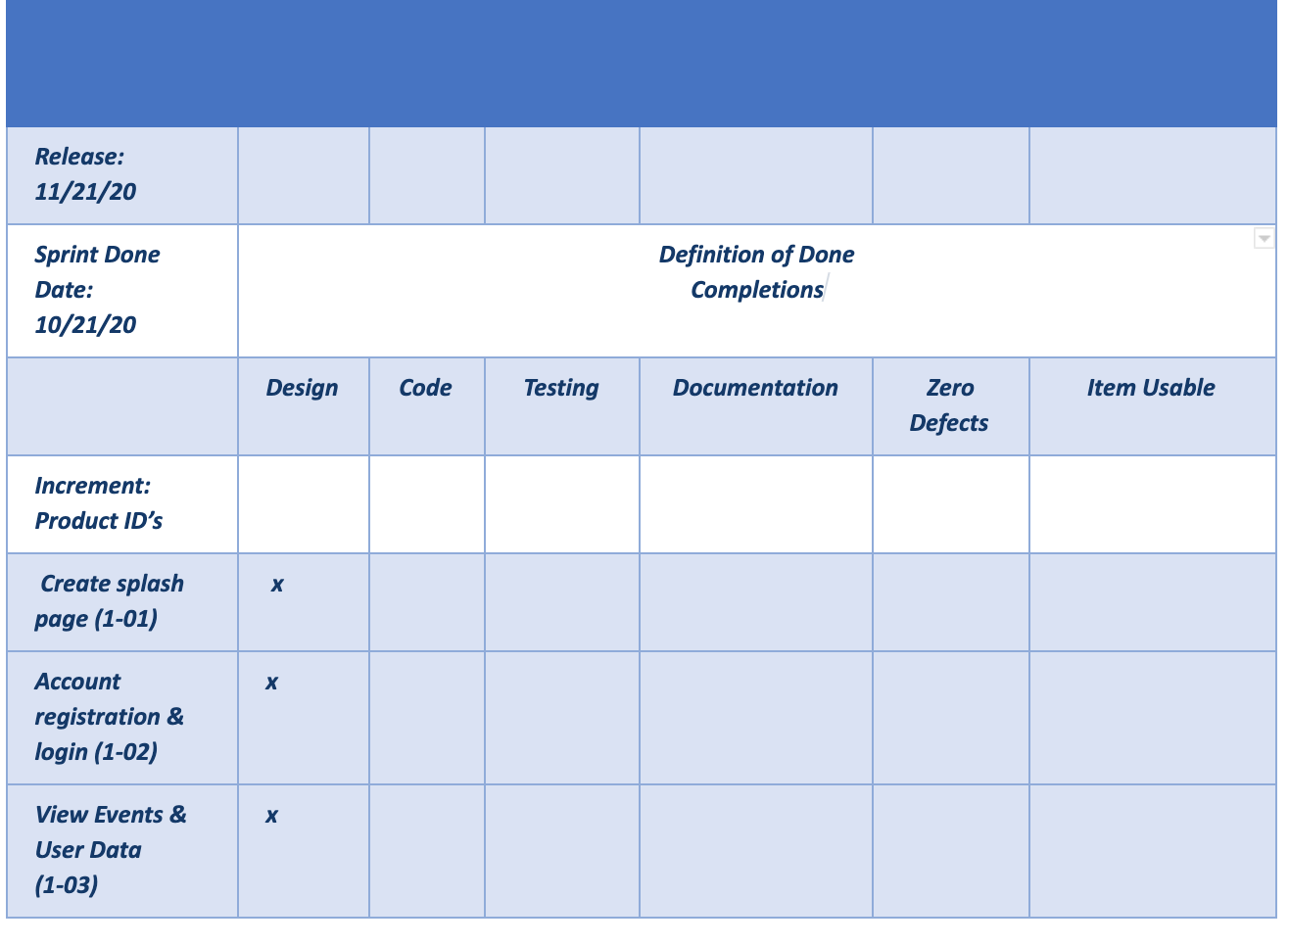
Product Increment
- For up to Phase 2, planning and designing are complete!
- Remaining tasks are in progress/will continue to be worked on.
- Release date:
1 month from now.

Slide 17
Burndown Chart

Slide 18
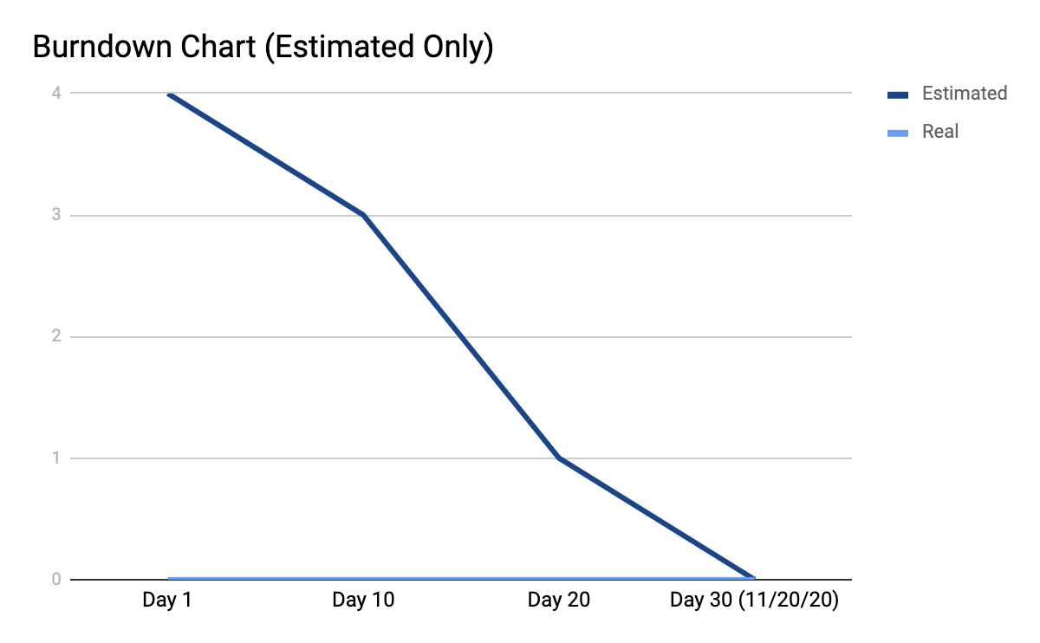

Slide 19
Any questions?

